Slide 2
SOUND
a range of compression wave
frequencies to which the
human ear is sensitive

Slide 3
The audio spectrum
extends from approximately
20 Hz to 20,000 Hz.

Slide 4
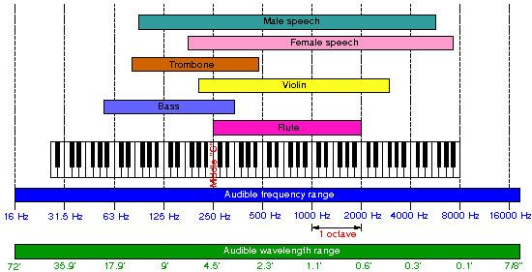
Range of Some Common Sounds

Slide 5
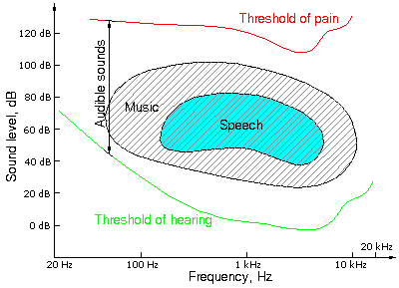
Intensity Range for Some Common Sounds

Slide 6
Sounds are produced by vibrating matter.
1. reeds
3. membranes
2. strings
4. air columns
Sound is a mechanical wave (longitudinal).
It will not travel through a vacuum.

Slide 7
Sounds possess the
characteristics
and properties that
are common to all
waves.

Slide 8
Just like all longitudinal (compression)
waves, sound waves possess a
velocity, frequency, wavelength,
phase, period, and amplitude.
Sound waves also reflect, refract,
diffract, and interfere.

Slide 9
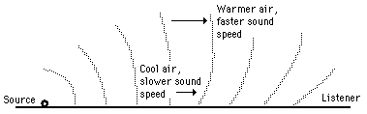
The velocity of sound in air depends
on the air temperature. The speed of
sound in dry air is 331.5 m/s at 0 ºC.
This speed
increases
with temperature: about 0.6 m/s
for every 1 ^{º}C increase in temperature.

Slide 10
Sound generally travels fastest
in solids and slowest in gases,
but there are some exceptions.
Medium Velocity (m/s) Medium Velocity (m/s)
Air 330 Carbon dioxide 260
Helium 930 Hydrogen 1270
Oxygen 320 Water 1460
Sea water 1520 Mercury 1450
Glass 5500 Granite 5950
Lead 1230 Pine wood 3320
Copper 3800 Aluminium 5100

Slide 11
The human ear relates
amplitude to
loudness
and
frequency to
pitch.

Slide 12
Doppler Effect
A tone is not always heard at the same frequency at
which it is emitted.
When a train sounds its horn as it passes by, the pitch of the horn changes from high to low.
Any time there is relative motion between the source of a sound and the receiver of it, there is a difference between the actual frequency and the observed frequency.

Slide 13


* Fact *
All objects have a natural
frequency of vibration.
Resonance - the inducing
of vibrations of a natural
rate by a vibrating source
having the same frequency
“sympathetic vibrations”

Slide 14
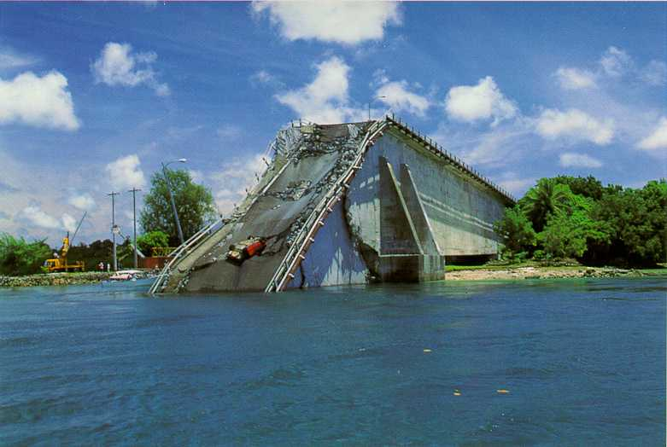
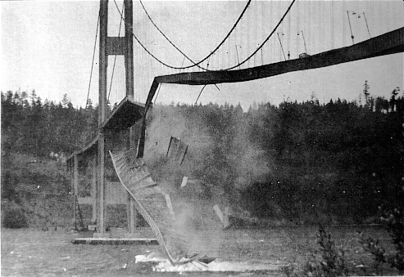
Famous Bridge Collapses:
Evidences of Resonance?
Tacoma Narrows link
Others link

